Slide 1

Hemorrhage Control in the Field Tourniquet & Direct Pressure
Pre-Hospital Management of Traumatic Brain Injury (TBI)
Group Members:
Areefa
Syed Salam
Presented to: Mam Fatima

Slide 2

Introduction
Trauma is a leading cause of death worldwide
Hemorrhage and TBI are major causes of preventable mortality
Early pre-hospital care saves lives
Focus on field management before hospital arrival

Slide 3
Objectives of Presentation
1
Understand hemorrhage control methods
2
Learn proper use of direct pressure and tourniquet
3
Understand pre-hospital management of TBI
4
Highlight evidence-based guidelines

Slide 4


Hemorrhage: Overview
Hemorrhage = excessive blood loss
Responsible for 30–40% of trauma deaths
Early control prevents shock and death
External bleeding is often preventable

Slide 5
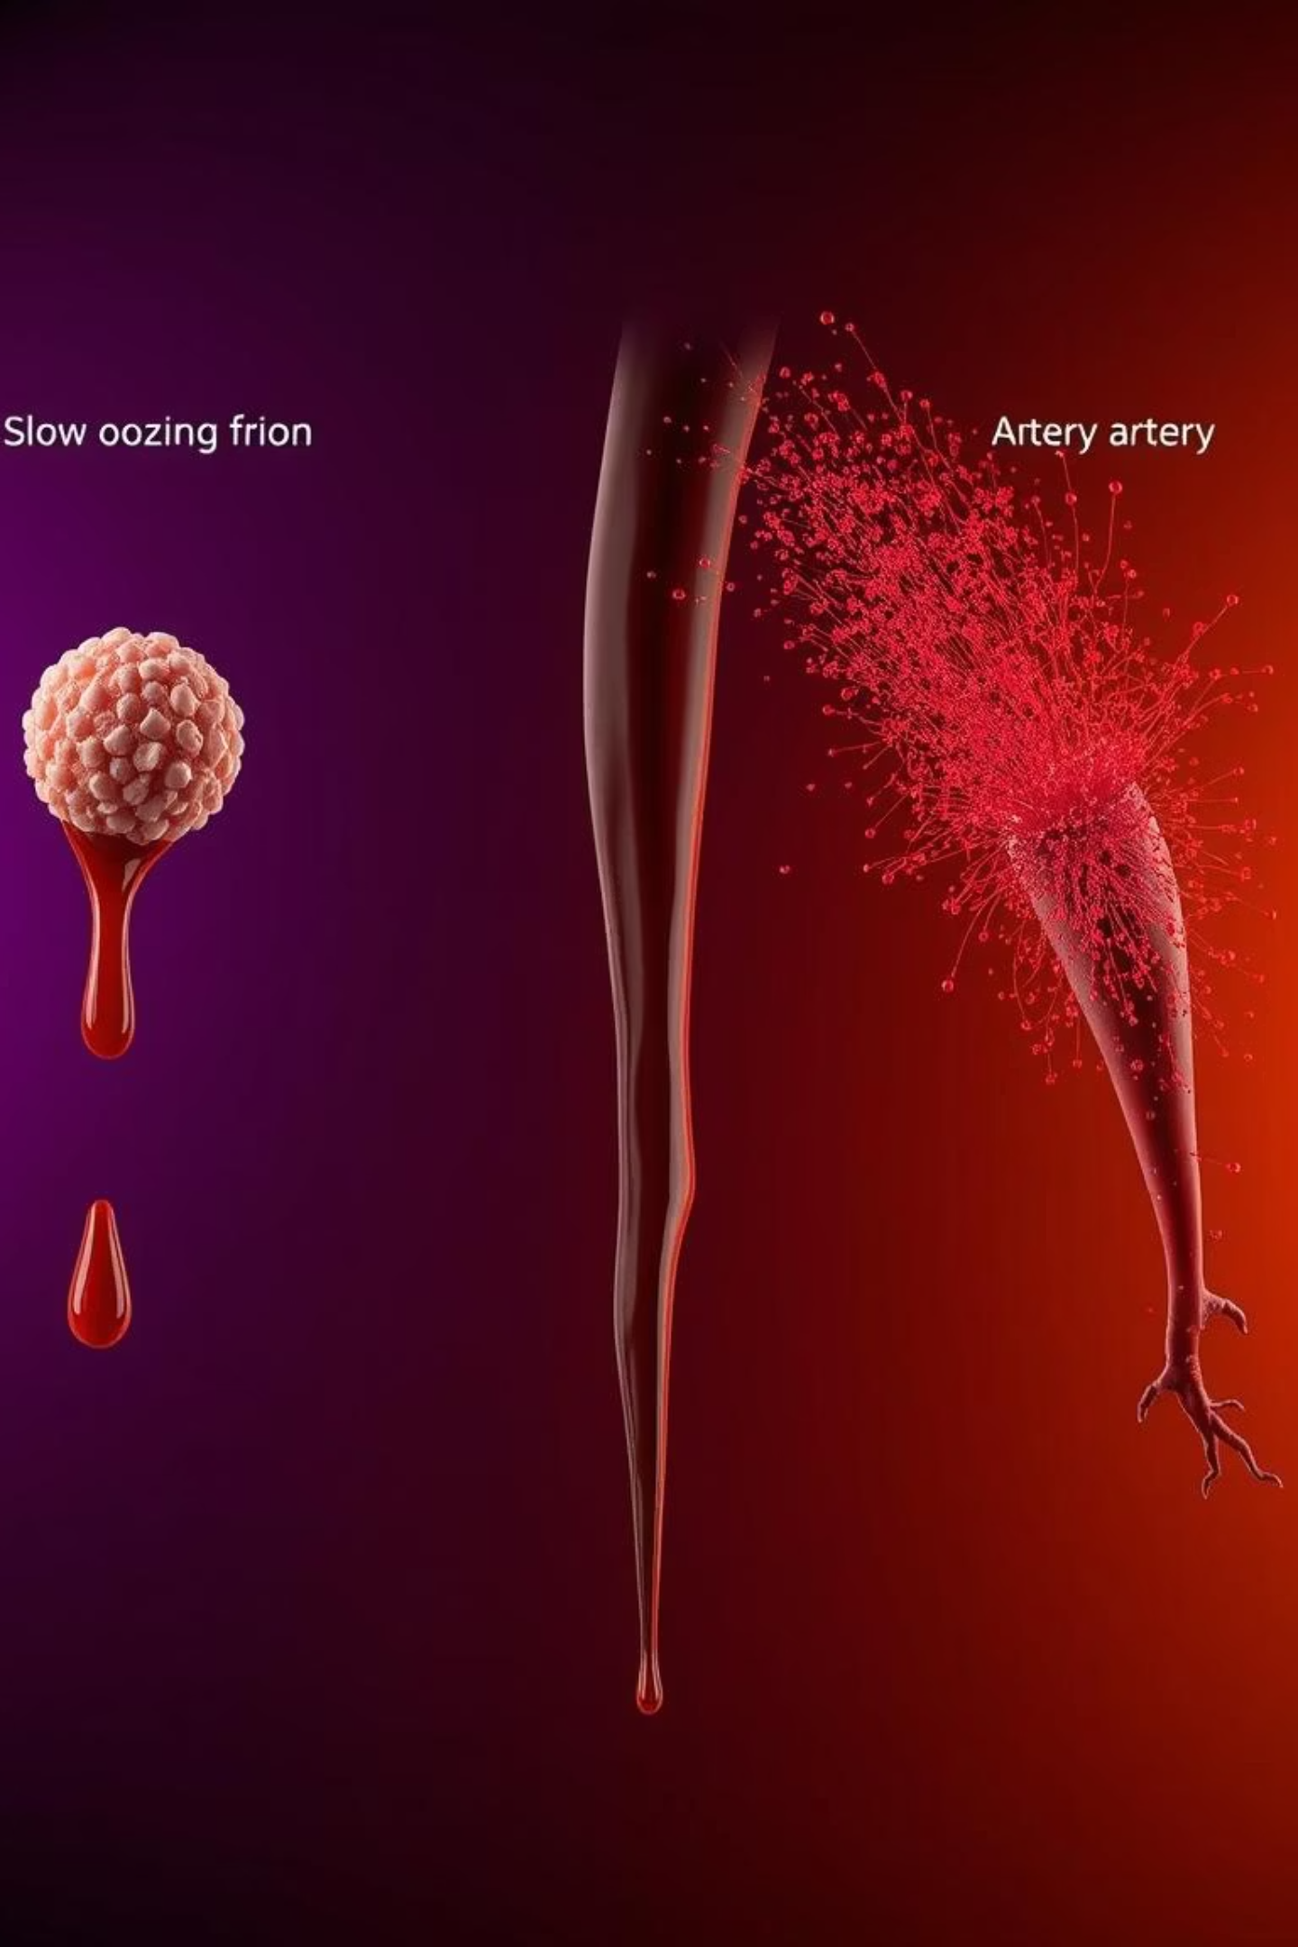
Types of External Hemorrhage
Capillary bleeding
Venous bleeding
– slow oozing
– steady dark flow
Arterial bleeding
– bright red, pulsatile (most dangerous)
Extremity bleeding is most common in the field

Slide 6






Goals of Hemorrhage Control
Stop bleeding rapidly
Maintain circulation
Prevent hypovolemic shock
Allow safe transport to hospital

Slide 7

Direct Pressure (Definition)
First-line method of hemorrhage control
Firm pressure applied directly to wound
Simple, fast, and effective
Requires minimal equipment

Slide 8
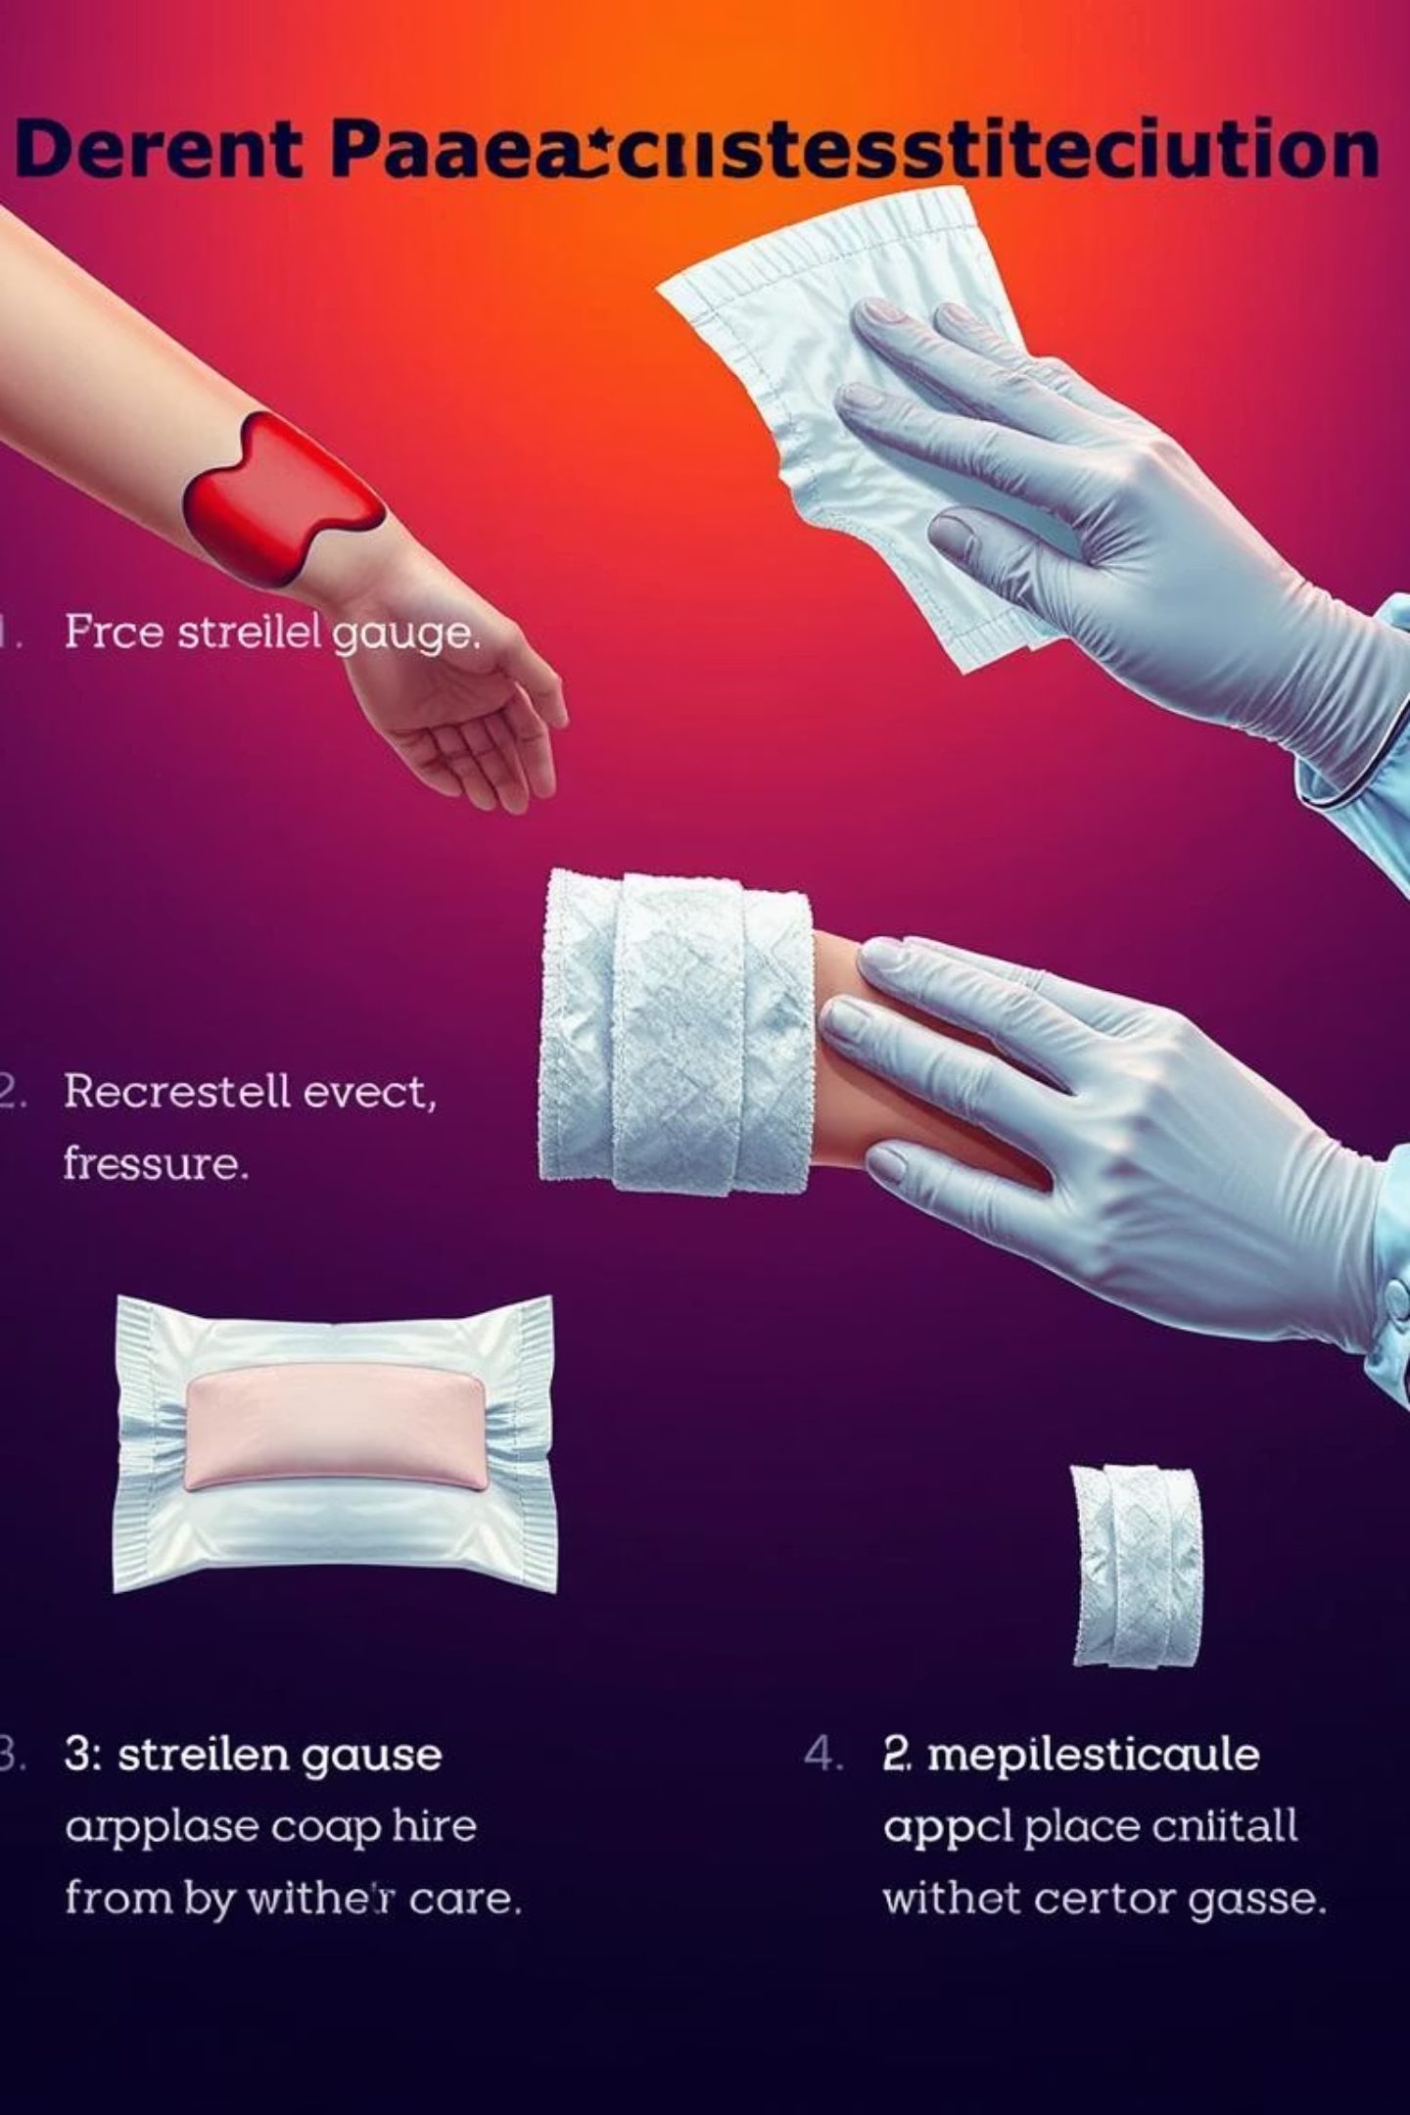
Direct Pressure (Technique)
01
02
Expose the wound
Apply sterile gauze or clean cloth
03
04
Press firmly for 5–15 minutes
Do not remove dressing repeatedly
05
Apply pressure bandage if available

Slide 9

Limitations of Direct Pressure
May fail in severe arterial bleeding
Not effective in traumatic amputations
Difficult in mass casualty situations
Requires continuous manual effort

Slide 10

Tourniquet (Definition)
Device used to stop blood flow to an extremity
Applied circumferentially
Controls life-threatening bleeding
Strongly recommended in modern trauma care

Slide 11
Indications for Tourniquet Use
Severe Hemorrhage
For uncontrolled bleeding from an extremity.
Traumatic Amputation
Essential for managing severe limb loss.
Direct Pressure Failure
When direct pressure isn't enough to stop bleeding.
Multiple Casualties
In situations with many injured individuals.
Rapid Evacuation
When quick transport is necessary.

Slide 12

Tourniquet Application
01
Placement
Place 5–7 cm above the wound, avoiding joints.
02
Tighten
Tighten until bleeding stops completely.
03
Note Time
Record the exact time of application.
04
No Field Removal
Do not remove the tourniquet in the field.

Slide 13

Tourniquet Myths vs. Reality
Old Belief: Causes Limb Loss
Historically, tourniquets were feared for causing limb damage.
Evidence: Saves Lives
Modern evidence shows tourniquets are crucial for survival.
Rare Complications
Complications are uncommon when applied correctly.
Delay is Dangerous
Delaying bleeding control poses a greater risk than proper tourniquet use.

Slide 14

Introduction to Traumatic Brain Injury (TBI)
Traumatic Brain Injury (TBI) is a disruption of brain function caused by external trauma, leading to significant disability and death.
Road Traffic Accidents
A leading cause of TBI.
Falls
Common in all age groups.
Assaults
Physical violence can result in TBI.

Slide 15
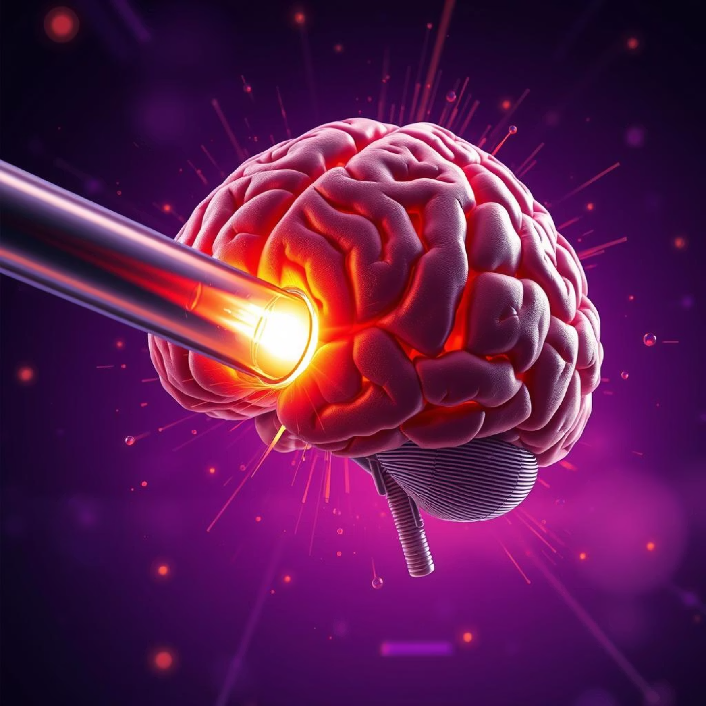

Primary vs. Secondary Brain Injury
Primary Injury
Secondary Injury
Occurs at the moment of impact and is irreversible.
Develops after the initial trauma and is often preventable with good care.
Hypoxia (lack of oxygen)
Hypotension (low blood pressure)
Brain swelling

Slide 16





Goals of Pre-Hospital TBI Management
Maintain Airway
Ensure clear breathing passages.
Ensure Oxygenation
Provide adequate oxygen supply.
Prevent Hypotension
Maintain stable blood pressure.
Maintain Cerebral Perfusion
Ensure sufficient blood flow to the brain.
Rapid Transport
Expedite transfer to a trauma center.

Slide 17

Airway & Oxygenation in TBI
Protect Airway
Use jaw thrust; avoid head tilt if cervical injury is suspected.
Maintain SpO₂
Keep oxygen saturation above 90%.
Suction Secretions
Clear any obstructions.
Oxygen Therapy
Administer as needed to maintain saturation.

Slide 18


Blood Pressure & Neuro Assessment
1
Avoid Hypotension
Maintain adult SBP ≥ 110 mmHg to ensure brain perfusion.
2
Monitor GCS
Regularly assess Glasgow Coma Scale for neurological status.
3
Pupil Check
Observe pupil size and reaction for signs of brain injury.
4
Frequent Reassessment
Continuously monitor patient during transport to the hospital.

Slide 19


Summary: Critical Trauma Care
Hemorrhage Control
TBI Management
Direct pressure is the first step.
Prevent hypoxia and hypotension.
Tourniquets are life-saving tools.
Early care significantly improves outcomes.
Pre-hospital care is absolutely critical for trauma survival, making a profound difference in patient outcomes.

Slide 20

Thank You
Any Questions?

